Slide 1
Lecture 20: Environmental Justice in Regulation 2
Prof. Austin
Environmental Economics Econ 475

Slide 2
Part 1: Environmental Justice Analysis for Regulatory Purposes

Slide 3
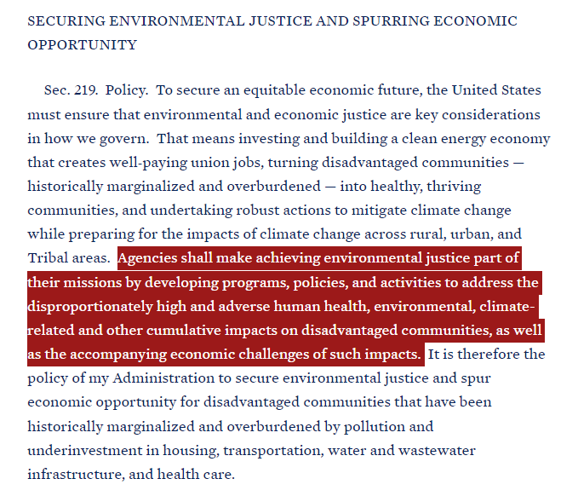
Environmental Justice Analysis as a Priority
Executive orders:
Executive order 12898
Executive order 14008
Signed January, 2021

Slide 4
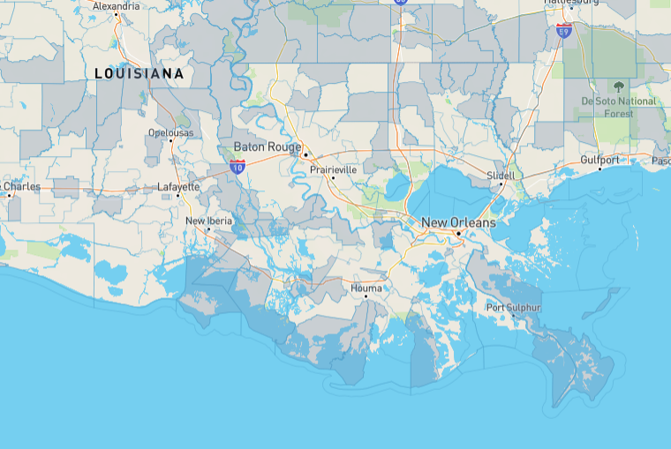
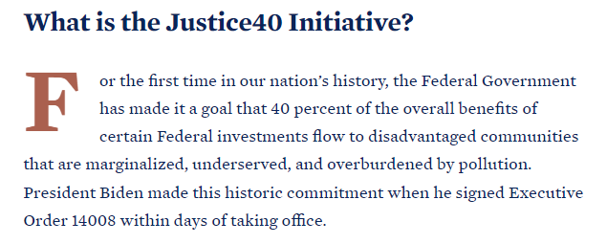
Justice40 Initiative
Figure: Disadvantaged communities in Southern Lousisiana according to CEJST (link to tool).

Slide 5

Environmental Justice Analysis as a Priority
The Administrator has asked Agency employees to “infuse equity and environmental justice principles and priorities into all EPA practices, policies, and programs.”
In the context of rulemakings:
“Assessing impacts to pollution-burdened, underserved, and Tribal communities in regulatory development processes and considering regulatory options to maximize benefits to these communities,” and
“Taking immediate and affirmative steps to improve early and more frequent engagement with pollution-burdened and underserved communities affected by agency rulemakings, permitting and enforcement decisions, and policies.”
- April 7, 2021 Administrator's Memo
Image source: Meet Michael Regan by NRDC

Slide 6
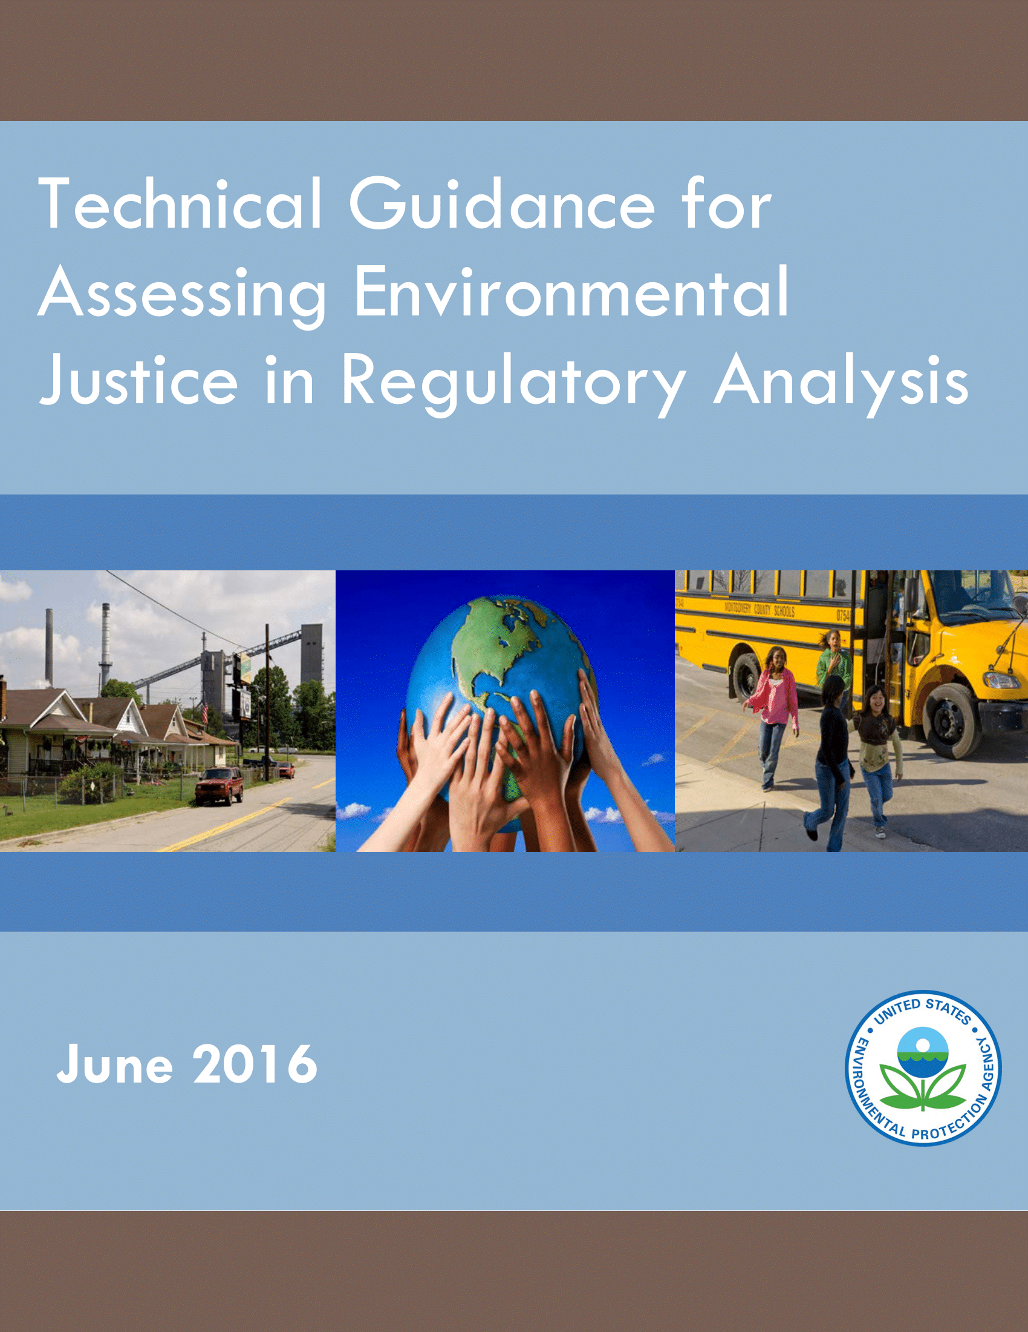
Environmental Justice Analysis
EPA’s Technical Guidance for EJ Analysis:
Underwent extensive internal review by all program offices, public comment, and peer review by EPA’s Science Advisory Board
Finalized in 2016 but never properly implemented
Outlines approaches for risk assessors and economists to evaluate EJ concerns for significant policy actions
2022 Strategic Goal to have EJ Analyses in at least 80% of significant policy actions.

Slide 7
What is an EJ Analysis?
What is not an EJ Analysis?
Saying no analysis is necessary because the action improves environmental quality.
Distributional analysis of costs and benefits.

Slide 8
Distributional Analysis ≠ EJ Analysis
An EJ analysis is distinct from a distributional analysis:
Distributional analysis is an evaluation of incidence of benefits or costs by different members of society (often income quintiles)
EJ analysis puts more emphasis on baseline conditions such as pre-existing exposure, cumulative impacts, and distribution of health impacts over population groups of concern.

Slide 9
Goals of EJ Analysis
An EJ Analysis seeks to answer three questions:
Is there evidence of potential EJ concerns in the baseline for population groups of concern?
Do the regulatory option(s) under consideration affect the potential EJ concern?
Do the regulatory option(s) under consideration exacerbate or mitigate EJ concerns relative to the baseline?

Slide 10
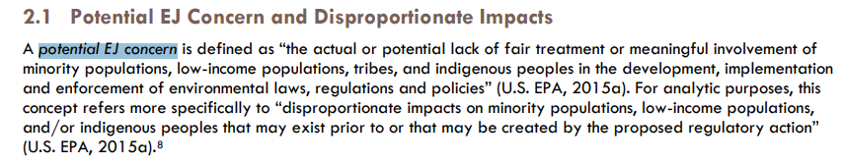
Key Terms: Potential EJ Concern
Procedural
Justice
Distributive
Justice

Slide 11
Other Key Terms
Groups of Concern
American Indian or Alaska Native, Asian, Black, Native Hawaiian and Pacific Islander, and Hispanic
Characteristics associated with vulnerability: low income, over age 65, under 5, women of child-bearing age, linguistic isolation, others
Baseline
The way the world looks absent a regulation (i.e., a counter-factual).

Slide 12
Key Terms: Vulnerability
“A matrix of physical, chemical, biological, social, and cultural factors that result in certain communities and subpopulations being more susceptible to environmental factors because of greater exposure to such factors or a compromised ability to cope with and/or recover from such exposure.”
Source: WHO (2006). Principles for Evaluating Health Risks in Children. Environmental Health Criteria 237

Slide 13
Some Steps in the Process
Early screening assessment:
Review availability of data and analytic methods
Evaluate literature and stakeholder input
Identify indicators of potential EJ concerns
Proximity, potential for hotspots, number of sources, nature and amounts of pollutants already impacting relevant populations, unique exposure pathways, unique vulnerabilities, etc.

Slide 14
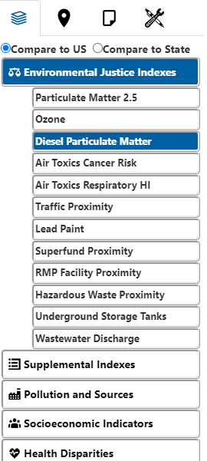
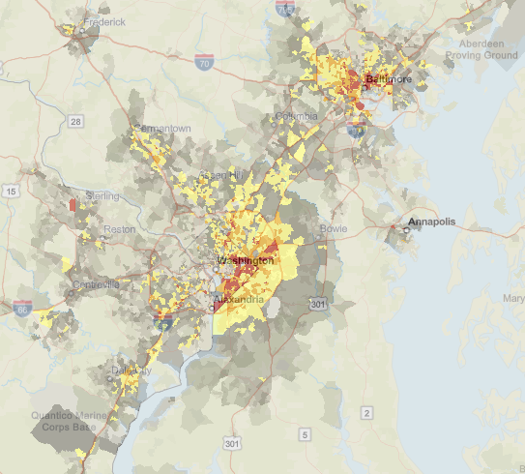
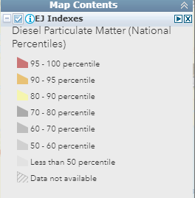
EJSCREEN version 2.0
Nationally consistent environmental and demographic data in maps
Block-group level data
State/national levels and percentiles as basis of comparison
Allows custom buffers, threshold maps, batch analyses
Indices to highlight the intersection between environmental and socioeconomic factors

Slide 15
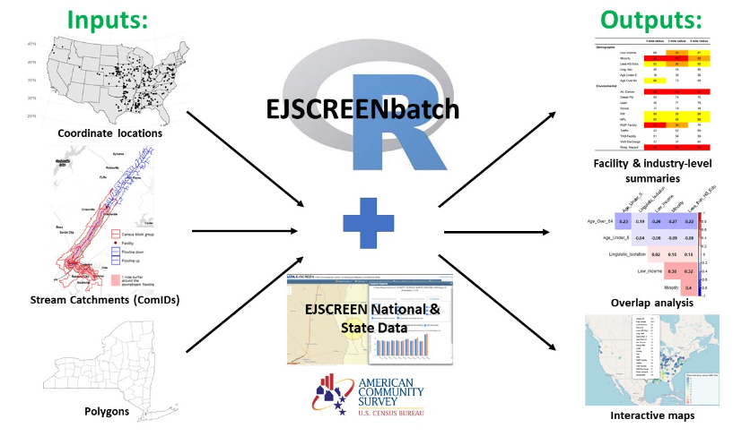
EJSCREENbatch
EJSCREENbatch is an open-source processing tool that allows inputting many locations and fetching aggregate EJSCREEN information and other demographic information.
Github repo.

Slide 16
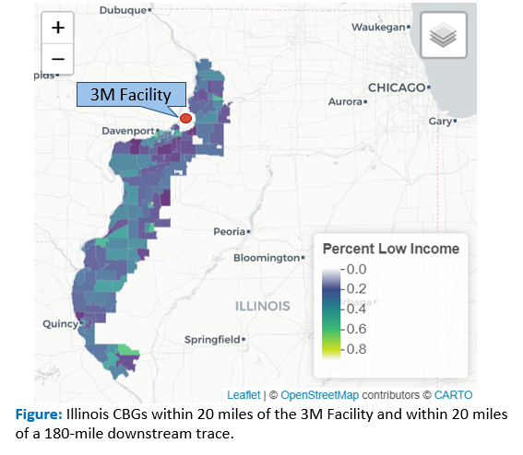
EJSCREENbatch: Example of 3M Plant in Cordova, Illinois
The 3M Specialty Film and Media Products Plant manufactures PFAS. According to NPDES DMR reports, it released:
26,000 kg of 10 unique PFAS, especially PFBA, over the period from 2018-2021.
A buffer approach for all tracts within 20-miles around the facility and a 180-mile distance downstream includes 282 CBGs with a population of 290,000.

Slide 17
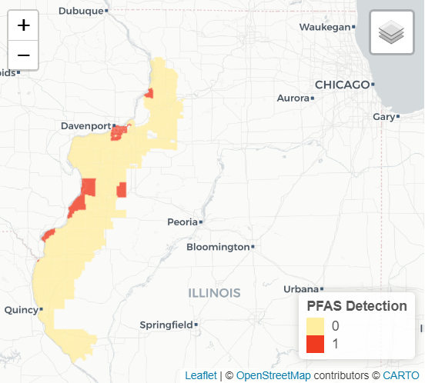
EJSCREENbatch: Example of 3M Plant in Cordova, Illinois
Service Boundaries can be used to screen across the 95 census block groups served by water systems with PFAS detections.
EJSCREEN Indicator | Average (Detect = 1) | Average (Detect =0) | State Average | National Average
Pct. Minority | 33.5 | 27.1 | 28.7 | 31.4
Pct. Low Income | 30.6 | 9.5 | 38.6 | 39.9
Pct. Linguistic Isolation | 2.5 | 0.6 | 4.8 | 5.4
PM 2.5 | 9.3 | 9.1 | 9.9 | 8.7
Traffic Proximity | 470.7 | 163.1 | 752.0 | 705.0
Pct pre-1960 Housing | 56.5 | 44.7 | 39.9 | 27.2
Population | 111,517 | 179,598
Figure: Illinois CBGs with a detection any of 12 PFAS from 2016-2021. Data source: Illinois Drinking Water Watch website

Slide 18
Other Steps in the Process
More in-depth assessment if warranted and where possible:
Select relevant geographic scope, scale, and comparison groups
Capacity for more nuanced approaches dictated in part by ability to build from risk and benefits assessments
Pre-proposal community engagement:
Recent examples: oil & gas NPSPS, steam electric ELG, PFAS NPDWR

Slide 19
How Analysis Ultimately Informs Regulatory Design
Economic Efficiency and Impacts
Environmental Justice, Technical Feasibility, Enforcement
Political, Institutional, and Statutory
Preferred Alternative(s)
Political Factors
Statutory Instruction
Institutional Feasibility
Benefits and Costs (Economic Efficiency)
Environmental Justice
Economic Impacts (Distribution)
Technical Feasibility
Enforceability
Ethics
Sustainability
Possible Regulatory Designs/Stringencies

Slide 20
Quantitative EJ Analyses 2012- 2021
Inventory of EJ analyses for economically significant final rules, Jan 2012 – Jan 2021.
More than half quantitatively evaluated potential EJ concerns
Majority only characterize baseline
Often rely on proximity analysis
Years | Total Final Rules | Total with EJ Analysis | Total with Quantitative EJ Analysis | Percent with Quantitative EJ Analysis
2012-14 | 11 | 6 | 5 | 45%
2015-17 | 12 | 11 | 7 | 58%
2018-21 | 11 | 9 | 6 | 55%
Total | 34 | 26 | 18 | 53%

Slide 21
Quantitative EJ Analyses 2012- 2021

Slide 22
Part 2: EJ Analyses for Regulations

Slide 23
Examples of EJ Analyses
Rule | Exposure/ Health Effects | Proximity Analysis | Visual Displays | Other Quantitative | Qualitative
Lead Clearance Standard (2020) | √ (BLLs; IQ loss)
Formaldehyde Stds for Composite Wood Products (2016) | √ (cancer; sensory irritation)
Definition of Solid Waste (2015) |  | √ |  | √ (other vulnerability factors)
Mercury and Air Toxics Standards (2011) | √ (IQ loss; mortality risk) | √ (as proxy for HAP exposure) | √ (for PM2.5 exposure) |  | √
CAFO Reporting Rule (2011) |  |  | √ (proximity)

Slide 24
AIM Act
American Innovation and Manufacturing (AIM) Act to incentivize less use of hydroflourocarbons (HFCs)
HFCs developed to replace ozone depleting substances
HFCs used in refrigeration, air conditioning, aerosols, fire suppression, and foam blowing sectors.
HFCs have global warming potential (GWP) hundreds to thousands of times greater than carbon dioxide

Slide 25
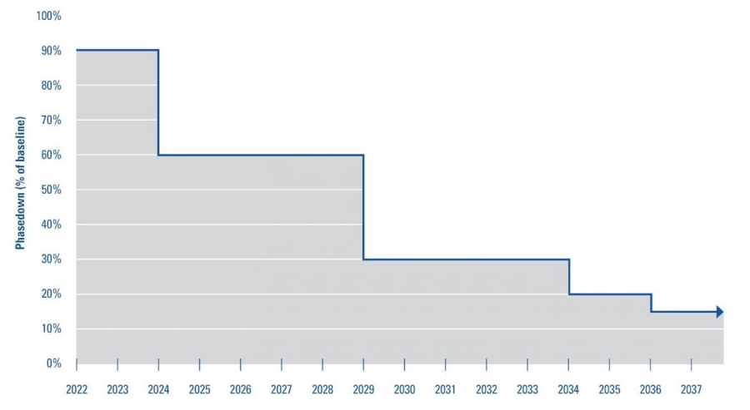
AIM Act
American Innovation and Manufacturing (AIM) Act to phase down use of hydroflourocarbons (HFCs):
Phase down schedule is based on allowances that can be traded.

Slide 26
AIM Act EJ Concerns
No local effects from direct exposure to HFCs
Potential EJ concerns about feedstocks, catalysts and byproducts of HFC production
Rely on toxic chemicals for production (e.g., carbon tetrachloride, hydrochloric acid, vinyl chloride, trichloroethylene (TCE), hydrogen fluoride)
Some lower GWP HFC alternatives also rely on toxic chemicals

Slide 27
AIM Act EJ Analysis
Key Elements:
Describe possible health effects of feedstock chemicals and potential risk of exposure for workers
Present profile of toxic releases associated with HFC production at each facility overall and by chemical
Proximity analysis to examine nearby community characteristics and cumulative risk of exposure
Summarize recent compliance and enforcement history of HFC facilities
Describe possible health effects from toxic chemicals used to produce HFC substitutes

Slide 28
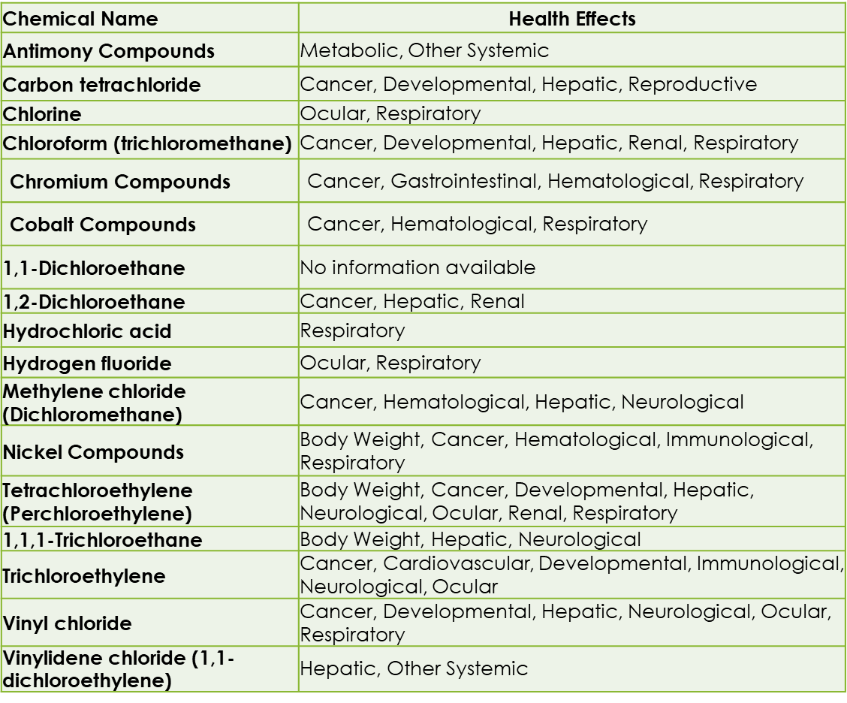
Health Effects of Byproducts or Feedstocks of HFC Production
HFC production uses chemical feedstocks and catalysts or produces byproducts that are toxic and/or may lead to serious health impacts for local communities and workers.

Slide 29
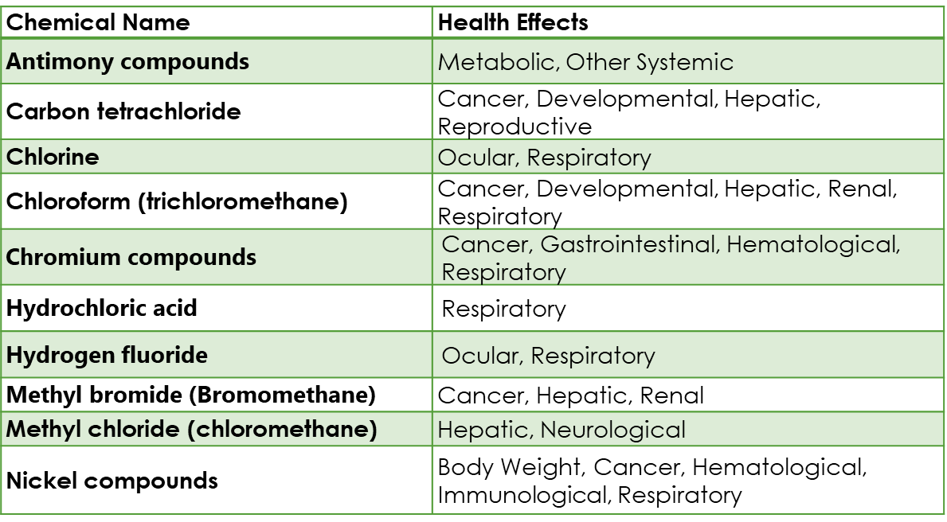
Health Effects of Byproducts or Feedstocks of HFC Substitute Production
Some substitutes also use chemical feedstocks or release byproducts that have adverse health effects for local communities or workers

Slide 30
Evaluation of 8 HFC Facilities
Facility name | City | State | Number of Employees | 2019 HFC Emissions (MT CO2e) | Air releases of toxic HFC production chemicals | Water releases of toxic HFC production chemicals | Offsite transfers of toxic HFC production chemicals
Arkema, Inc. | Calvert City | Kentucky | 200 | 843,010 | 58,043 | 456 | 501
Chemours - Corpus Christi Plant | Gregory | Texas | 250 | 17,240 | 34,876
Chemours El Dorado | El Dorado | Arkansas | 21 | 66,990 | 9,868
Chemours Louisville | Louisville | Kentucky | 127 | 3,707,770 | 3,724 |  | 196
Daikin America | Decatur | Alabama | 200 | 5,297 | 3,313 | 22 | 30
Honeywell - Geismar Complex | Geismar | Louisiana | 250 | 413,584 | 51,282 | 499 | 62,543
Iofina Chemical Inc. | Covington | Kentucky | 100 | NR
Mexichem Fluor Inc. | Saint Gabriel | Louisiana | 67 | 18,331 | 4,369 | 28 | 73

Slide 31
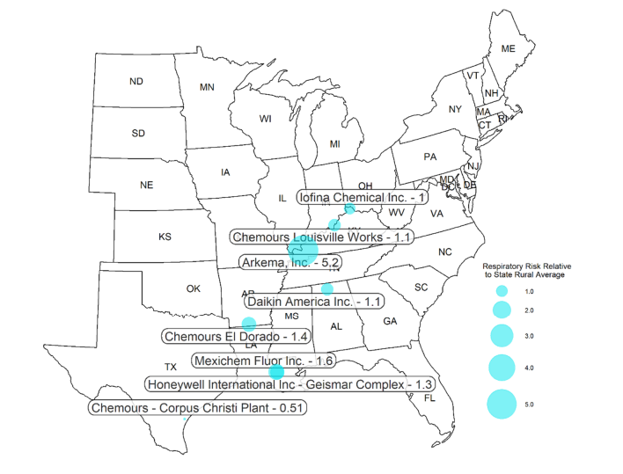
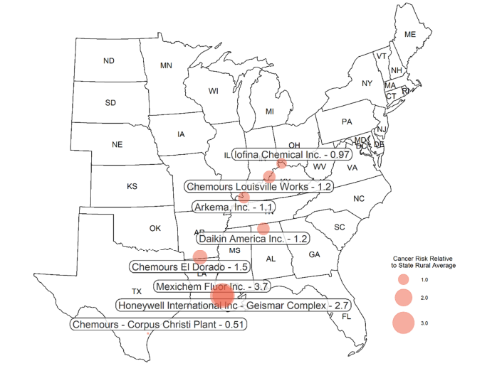
Evaluation of 8 HFC Facilities

Slide 32
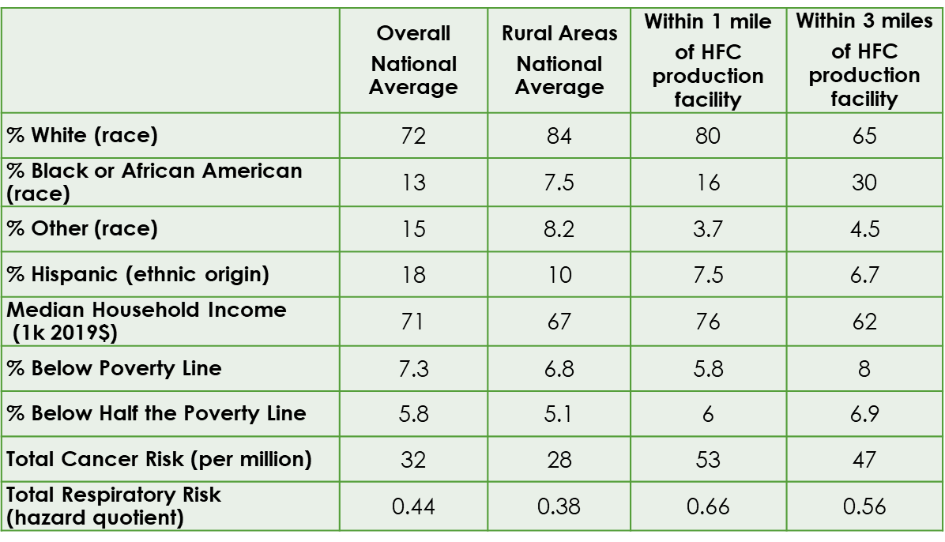
Community Profile Analysis of 8 HFC Facilities
Proximity analysis characterized communities near 8 HFC facilities.
1-, 3-, 5- and 10-mile buffers
Overall and for each facility
Very high NATA cancer risks around LA facilities
Not only due to HFC production

Slide 33
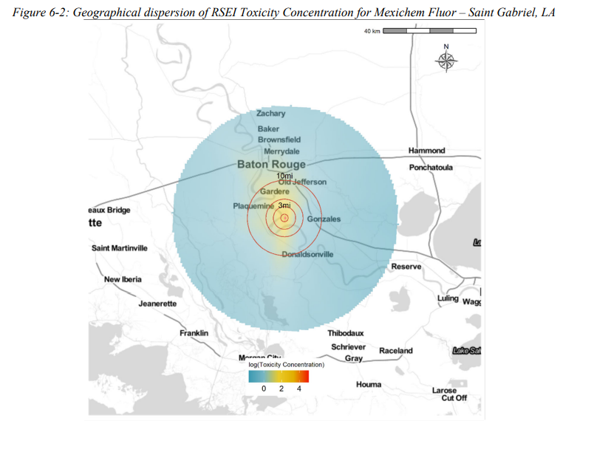
Facility Emissions Transport Modelling
Modelled pollution transport modelling for specific facilities with the highest respiratory hazard (link to Regulatory Impact Analysis).

Slide 34
AIM Act EJ Analysis Conclusions
Conclusions:
Baseline cancer and respiratory risks from air toxics vary but are generally higher close to an HFC production facility
Higher percentages of low-income and Black individuals live near HFC production facilities compared with the overall average at the national level.
Potential changes in toxic emissions might be unevenly distributed in ways that impact low-income and minority communities differentially.
Predicting these effects ex ante is difficult due to limited information on where and in what quantities specific substitutes will be produced.

Slide 35
Part 3: Retrospective Analyses

Slide 36
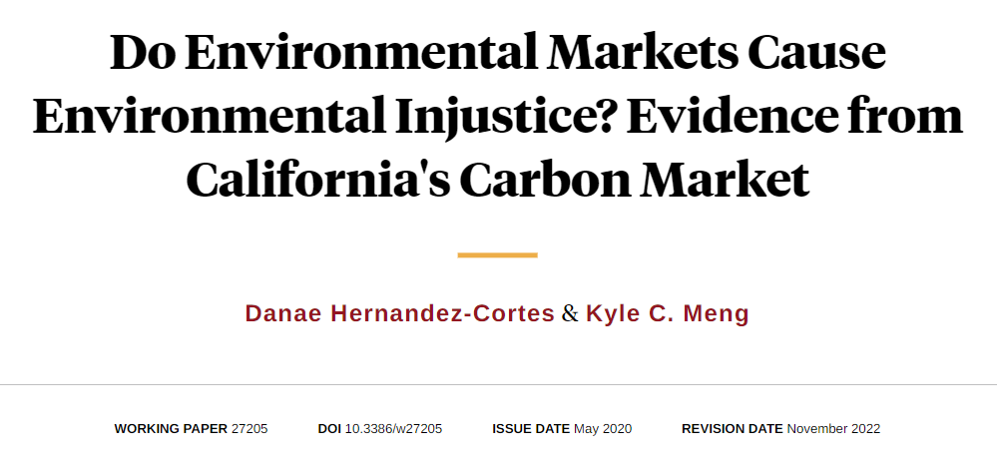

Slide 37
Hernandez-Cortes and Meng (2022)
Research Questions:
How did the 2013 introduction of California’s carbon market affect emissions of GHGs, PM 2.5, PM 10, NOx, and Sox from C&T regulated facilities?
How did the carbon cap and trade system affect disparities in pollution exposure for disadvantaged zip-codes in California?
Methods:
Modified difference-in-differences (trend-break model)
Pollution transport modelling (HYSPLIT)

Slide 38
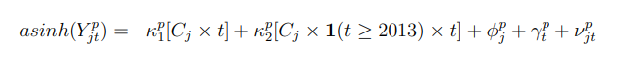
Hernandez-Cortes and Meng (2022)
How did the 2013 introduction of California’s carbon market affect emissions of GHGs, PM 2.5, PM 10, NOx, and Sox from C&T regulated facilities?
Inverse hyperbolic sine transform means point estimates are percentage changes in emissions
Control for differential pre-trends in the treatment group
Change in differential trend after treatment
Facility and year fixed effects

Slide 39
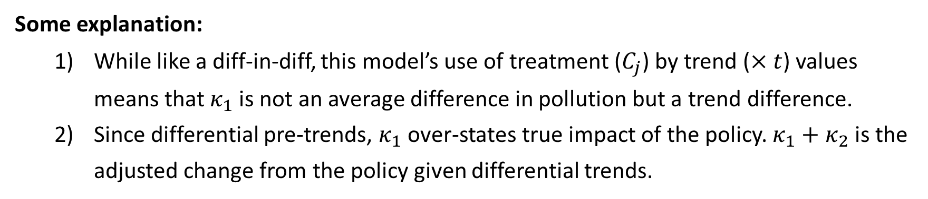
Hernandez-Cortes and Meng (2022)
How did the 2013 introduction of California’s carbon market affect emissions of GHGs, PM 2.5, PM 10, NOx, and Sox from C&T regulated facilities?
Some explanation:
While like a diff-in-diff, this model’s use of treatment ($C_{j}$) by trend ($×t$) values means that $κ_{1}$is not an average difference in pollution but a trend difference.
Since differential pre-trends, $κ_{1}$over-states true impact of the policy. $κ_{1}+κ_{2}$ is the adjusted change from the policy given differential trends.

Slide 40
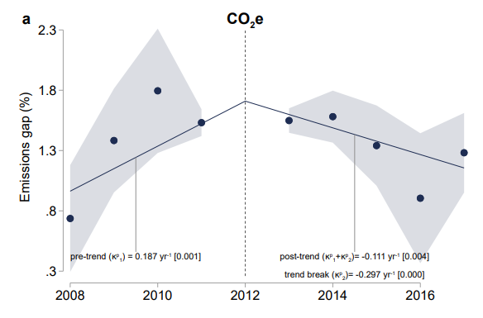
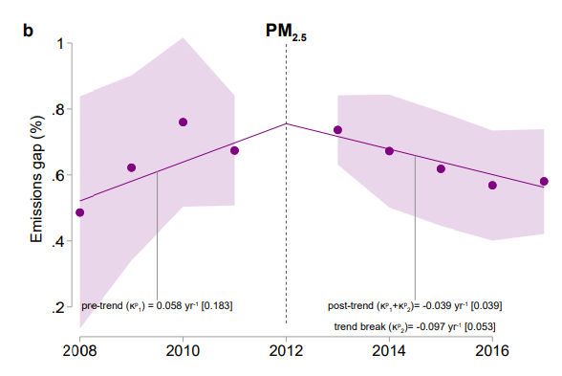
Hernandez-Cortes and Meng (2022)

Slide 41
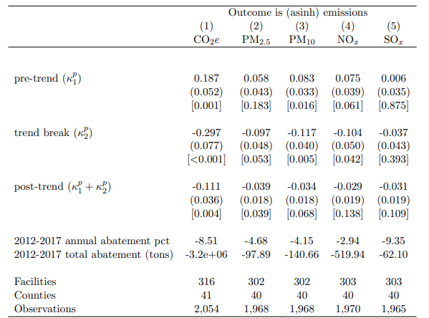
Hernandez-Cortes and Meng (2022)
Key results to (1):
Before policy, gap between CO2e emissions for regulated vs. non-C&T firms was growing by 19 PP each year.
Hard to interpret PP. Think of it like going from 130% higher emissions to 149% higher.

Slide 42
Hernandez-Cortes and Meng (2022)
Key results to (1):
2) After policy, gap between CO2e emissions for regulated vs. non-C&T firms was decreasing by 11 PP each year.
Average annual percent change in emissions.

Slide 43
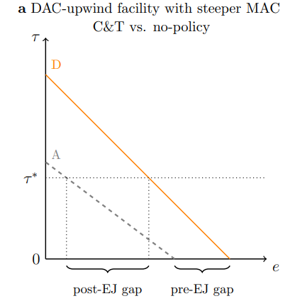
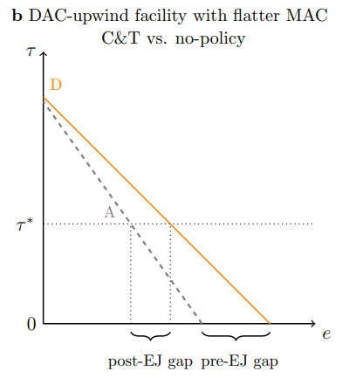
Hernandez-Cortes and Meng (2022)
2) How did the carbon cap and trade system affect disparities in pollution exposure for disadvantaged zip-codes in California?

Slide 44
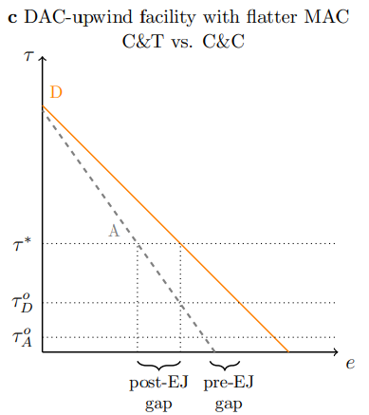
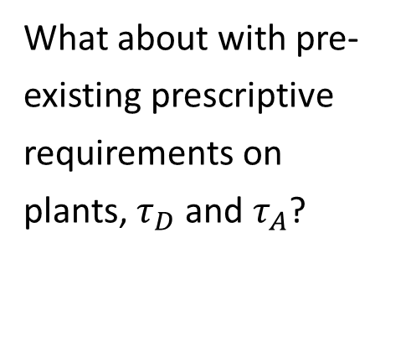
Hernandez-Cortes and Meng (2022)
What about with pre-existing prescriptive requirements on plants, $τ_{D}$ and $τ_{A}$?
Abatement starting point for D (disadvantaged community) .
Abatement starting point for A, non-disadvantaged.

Slide 45
Hernandez-Cortes and Meng (2022)
2) How did the carbon cap and trade system affect disparities in pollution exposure for disadvantaged zip-codes in California?
Need to determine how emissions in one location map to concentrations elsewhere (moving beyond unit hazard and proximity approaches).
What is a “disadvantaged” community?

Slide 46
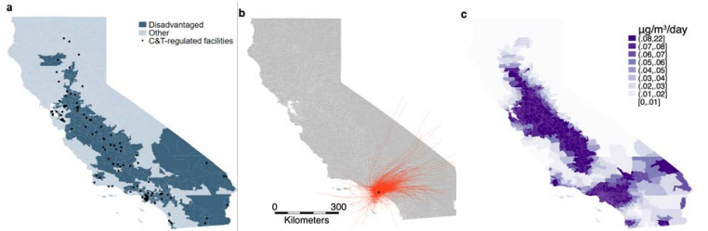
Hernandez-Cortes and Meng (2022)
Definition of disadvantaged from CalEnviroScreen.
HYSPLIT model uses plant features, weather, and C&T-driven emissions to model transport.
C&T-facility-driven pollution concentration across zipcodes from HYSPLIT model.

Slide 47
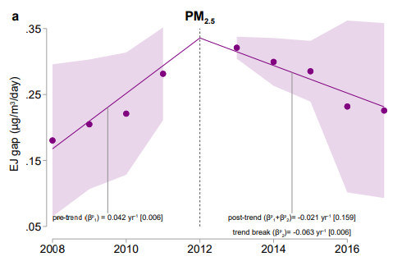
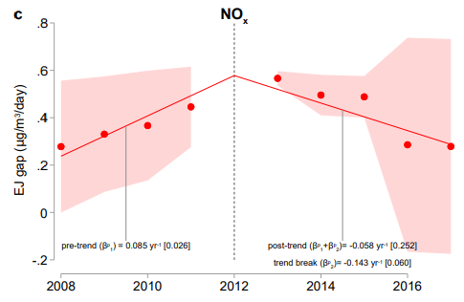
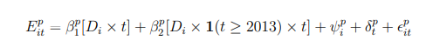
Hernandez-Cortes and Meng (2022)

Slide 48
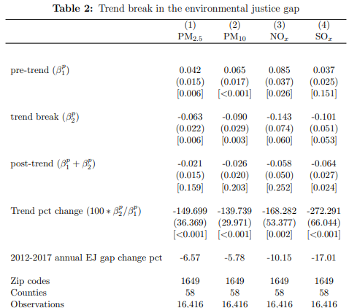
Hernandez-Cortes and Meng (2022)
Key results to (2):
1) Before policy, EJ gap from C&T regulated facilities was widening.
2) After policy, facilities subject to regulation released emissions that caused EJ gaps to narrow by 6-10% annually.

Slide 49
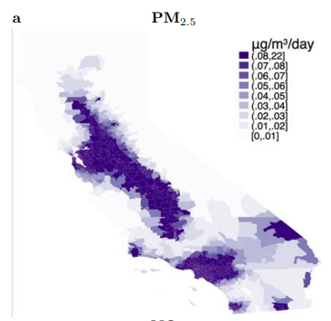
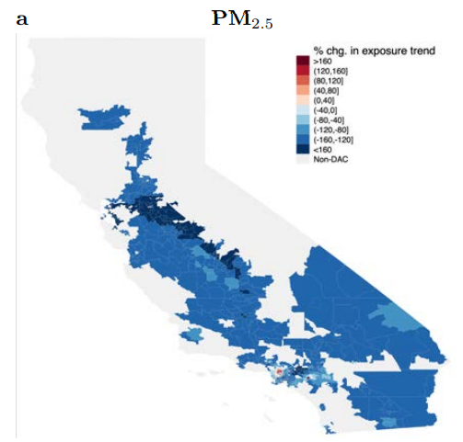
Hernandez-Cortes and Meng (2022)

Slide 50
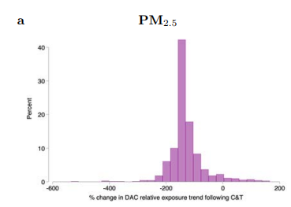
Hernandez-Cortes and Meng (2022)

Slide 51
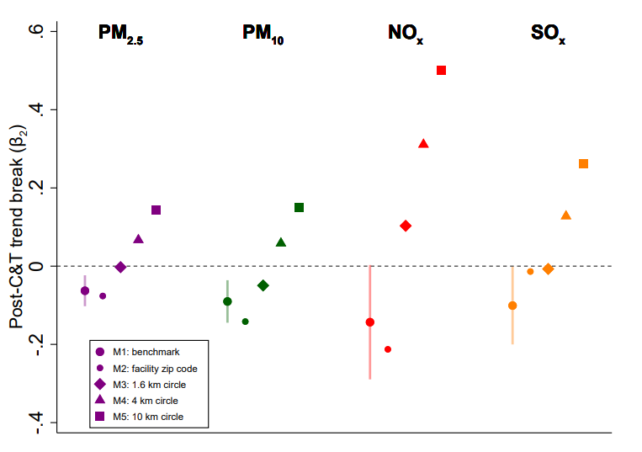
Hernandez-Cortes and Meng (2022)
Final point:
Fate and transport modelling really affected their results.
Using just facility locations or buffering circles would have led to the opposite conclusion.

Slide 52
Recap
We saw from Hernandez-Cortes and Meng (2022) that California’s C&T program decreased EJ gaps within the state:
8.5% annual decrease in PM 2.5 emissions relative to control facilities
6.5% annual EJ gap percent change for PM 2.5

Slide 53
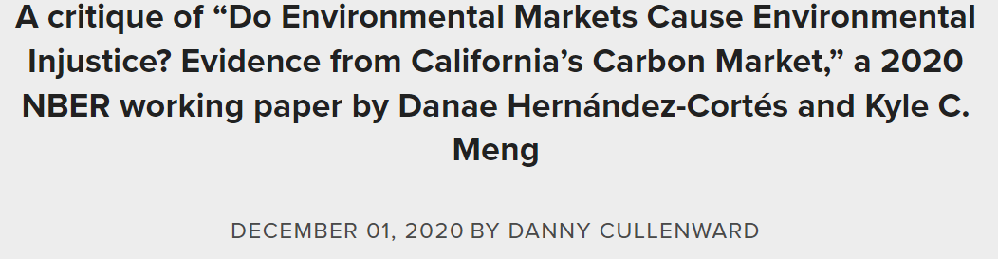
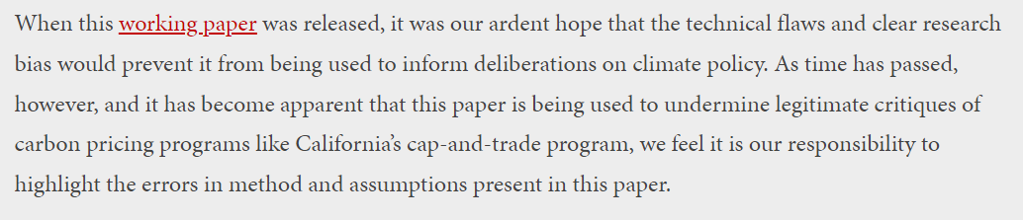
Controversy
Hernandez-Cortes and Meng (2022) was very controversial when a prior version in 2020 was released.
Danny Cullenwald and Katie Valenzuela’s response in 2020.

Slide 54

Cullenwald’s Critique
Five errors highlighted:
Inaccurate definition of environmental justice communities
Data quality issues with emissions reporting and monitoring
Control group bias
Omitted variable bias
The question is not cap-and-trade vs. nothing
Image source.

Slide 55
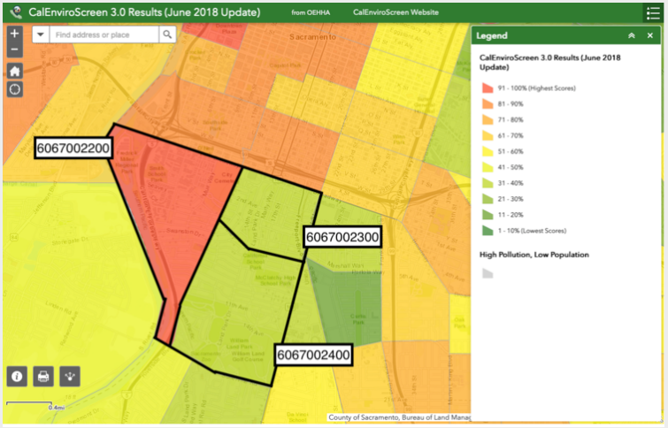
Cullenwald’s Critique
Inaccurate definition of environmental justice communities
- Zipcode vs. neighborhood

Slide 56
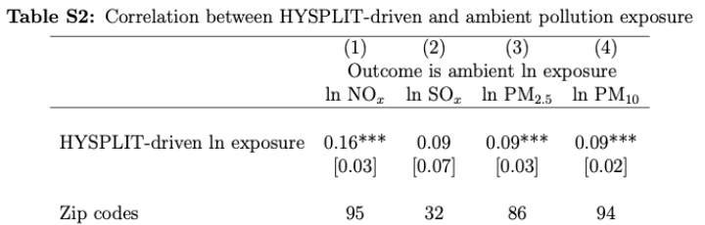
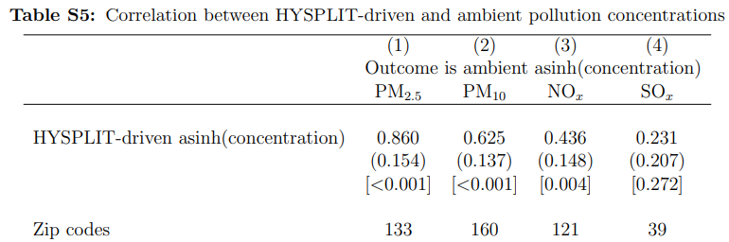
Cullenwald’s Critique
2) Data quality issues with emissions reporting and monitoring
ambient pollution at any location is composed of emissions originating from many sources
2020 paper.
2022 paper.

Slide 57
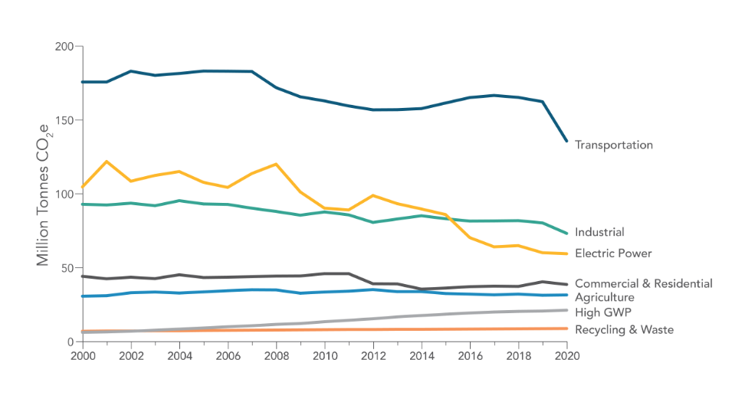
Cullenwald’s Critique
2) Data quality issues with emissions reporting and monitoring
California’s own data show industrial emissions not improving much.

Slide 58
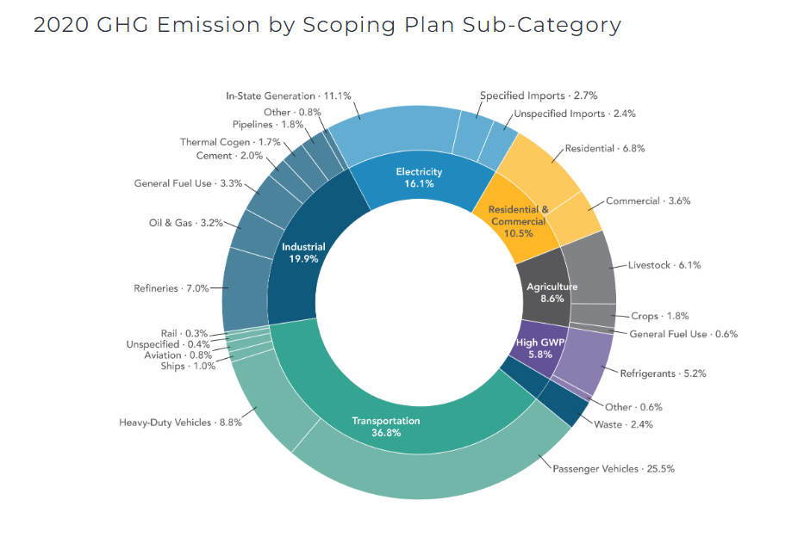
Cullenwald’s Critique
3) Control Group Bias
Facilities over 75th percentile of GHG emissions dropped, all refineries and electricity generators dropped. 70% of reported California 2008-2012 GHG emissions excluded

Slide 59
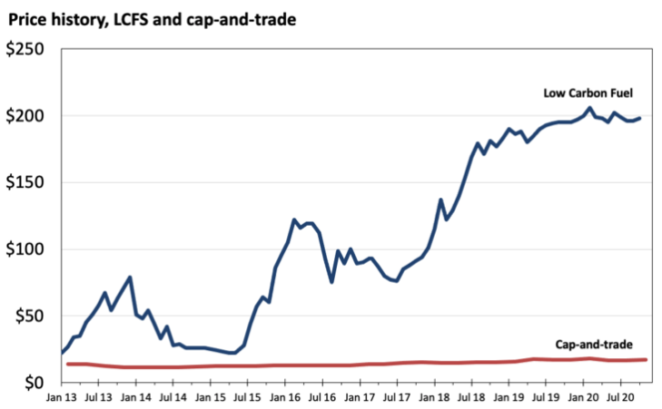
Cullenwald’s Critique
4) Omitted variable bias
Low carbon fuel standards are also a cap and trade at the same time (started 2011). LCFS prices increased rapidly while C&T didn’t move.
C&T price not generally binding
(see Cullenwald et al, 2019).

Slide 60
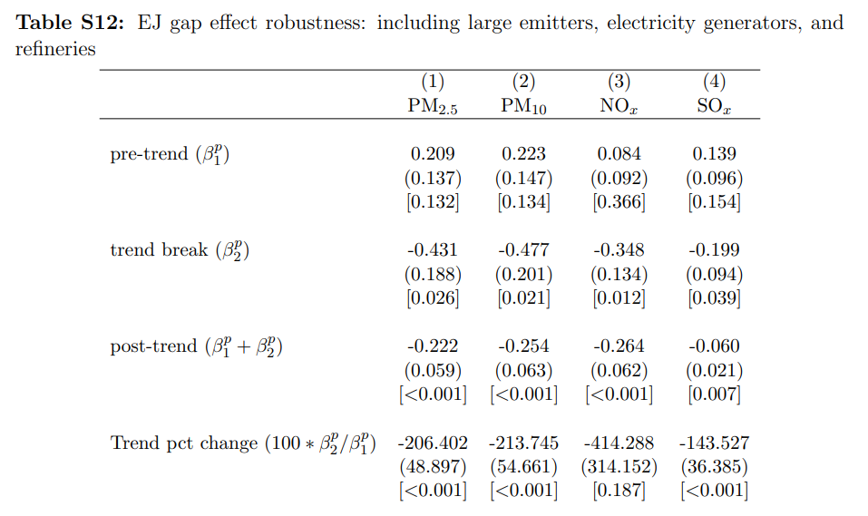
Cullenwald’s Critique
4) Omitted variable bias
Low carbon fuel standards affect refineries, largest sector within industrial category.

Slide 61
Cullenwald’s Critique
5) The question is not cap-and-trade vs. nothing. Argues for:
Stronger cap and trade with fewer allowances
More prescriptive regulations on releasers
More of both policies
“It's not news that a flawed program is better than no program at all, but that's all the paper looks at.”
Notes:
Probably unfair of C&V to say that’s all the paper looks at, or that it’s ‘not news’

Slide 62
Two Perspectives
Adopting a weak cap-and-trade program has led to prolonged and higher emissions in environmental justice communities than if California had adopted a stringent carbon pricing policy or relied instead on non-market mechanisms that would have been targeted at the pollution reductions our communities need.
- Cullenwald and Valenzuela
More generally, despite these findings for California, market-based environmental policies should not be used explicitly to address environmental justice concerns. Market-based policies are intended for allocative efficiency and not distributional objectives… environmental justice problems need environmental justice policies.
- Hernandez-Cortes and Meng
Notes:
Notice that the arguments are speaking past each other to an extent.
Cullenwald and Valenzuela are arguing for a stronger cap-and-trade. They are suggesting HC&M’s paper gives us a false sense of confidence about the positive benefits to EJ communities of a flawed cap and trade
HC&M reduce C&V’s argument to one of ‘more protection for EJ communities’ without addressing that the main point of C&V is ‘more stringent regulations across the board would do more for EJ communities’

Slide 63
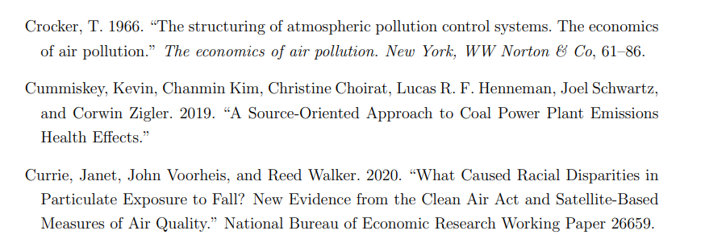
A Response to Cullenwald
!!!

Slide 64
Next class
Have a nice weekend. Your fourth case study is due next week! It is a simple coding assignment, but some might have issues downloading the requisite R packages. Let me or your TAs know if you’re facing difficulty with the script.
Next Monday we’ll spend more time talking about real implications of environmental policies. Your readings:
K&O Chapter 10
Borenstein and Kellogg (2022)

